Slide 1
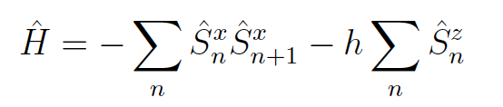
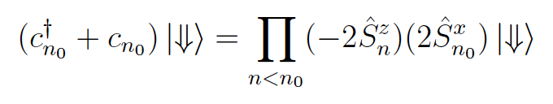
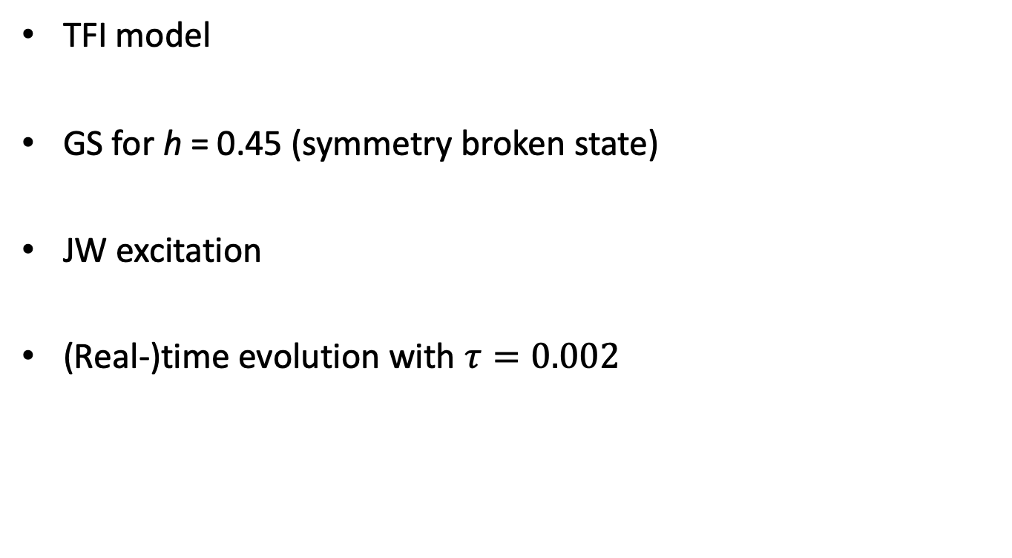
Some results
TFI model
GS for h = 0.45 (symmetry broken state)
JW excitation
(Real-)time evolution with $τ=0.002$

Slide 2
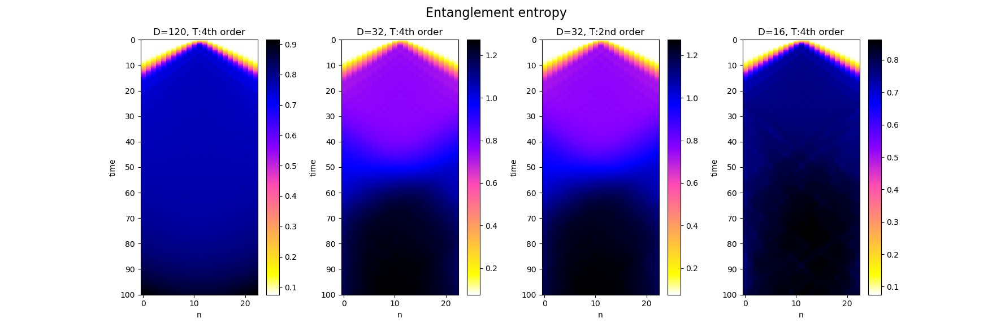
Notes:
- For D=120 – very delayed reflection (and it looks somehow ‘spread out”); for D=16 – reflection occurs much earlier
- Bond dimension plays more important role than the order of the Trotter decomposition

Slide 3
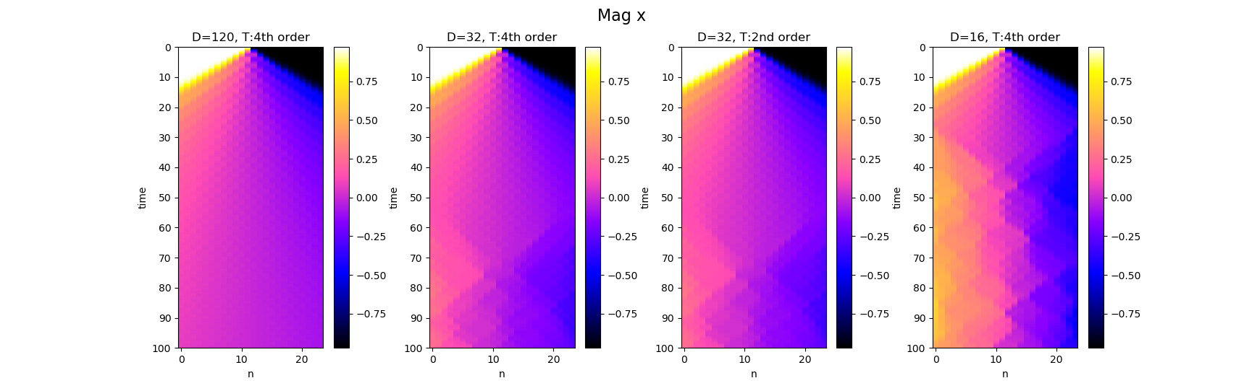

Slide 4
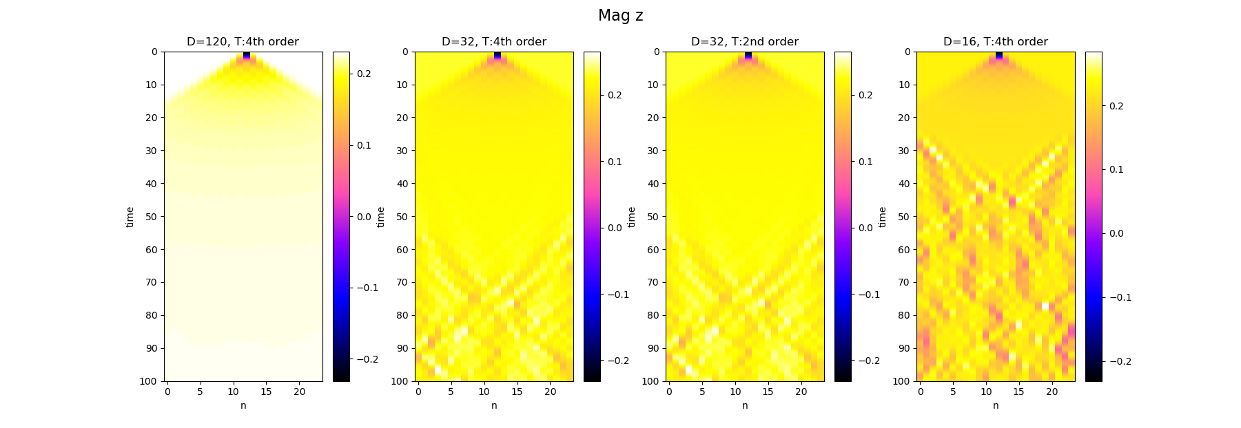

Slide 5
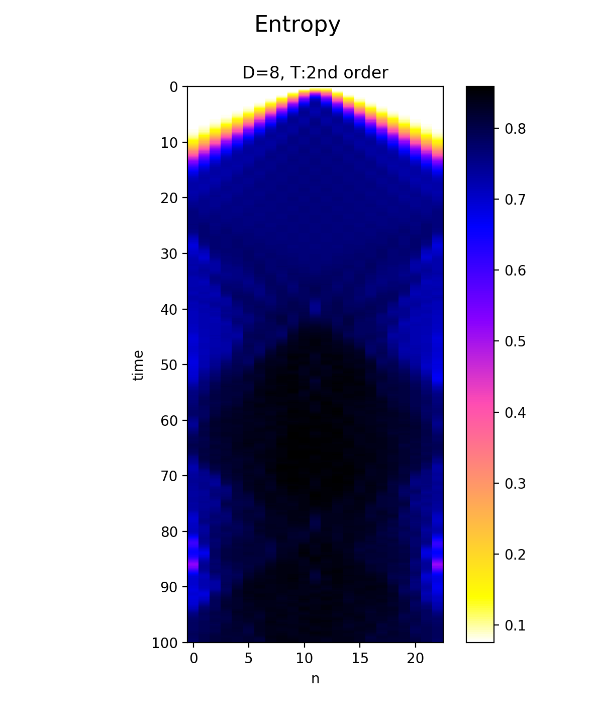
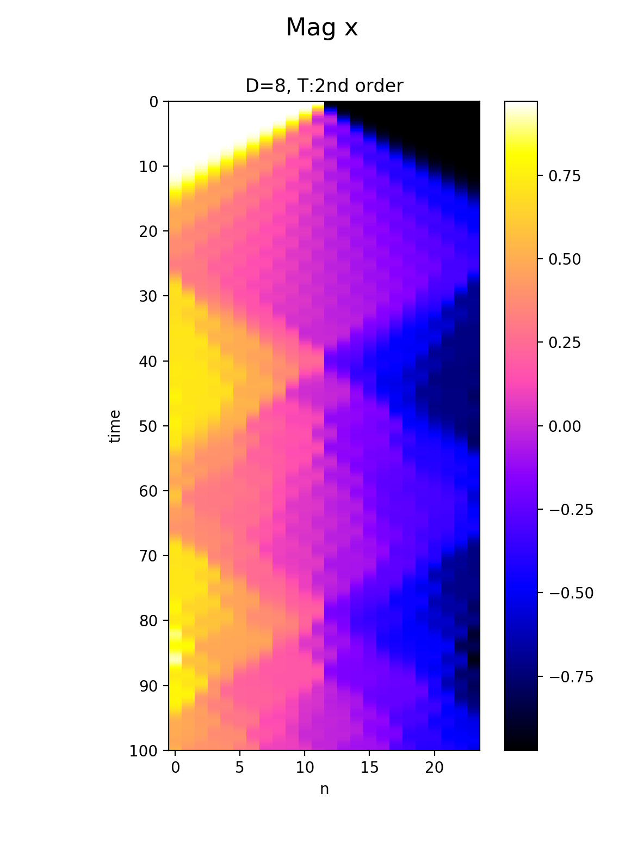
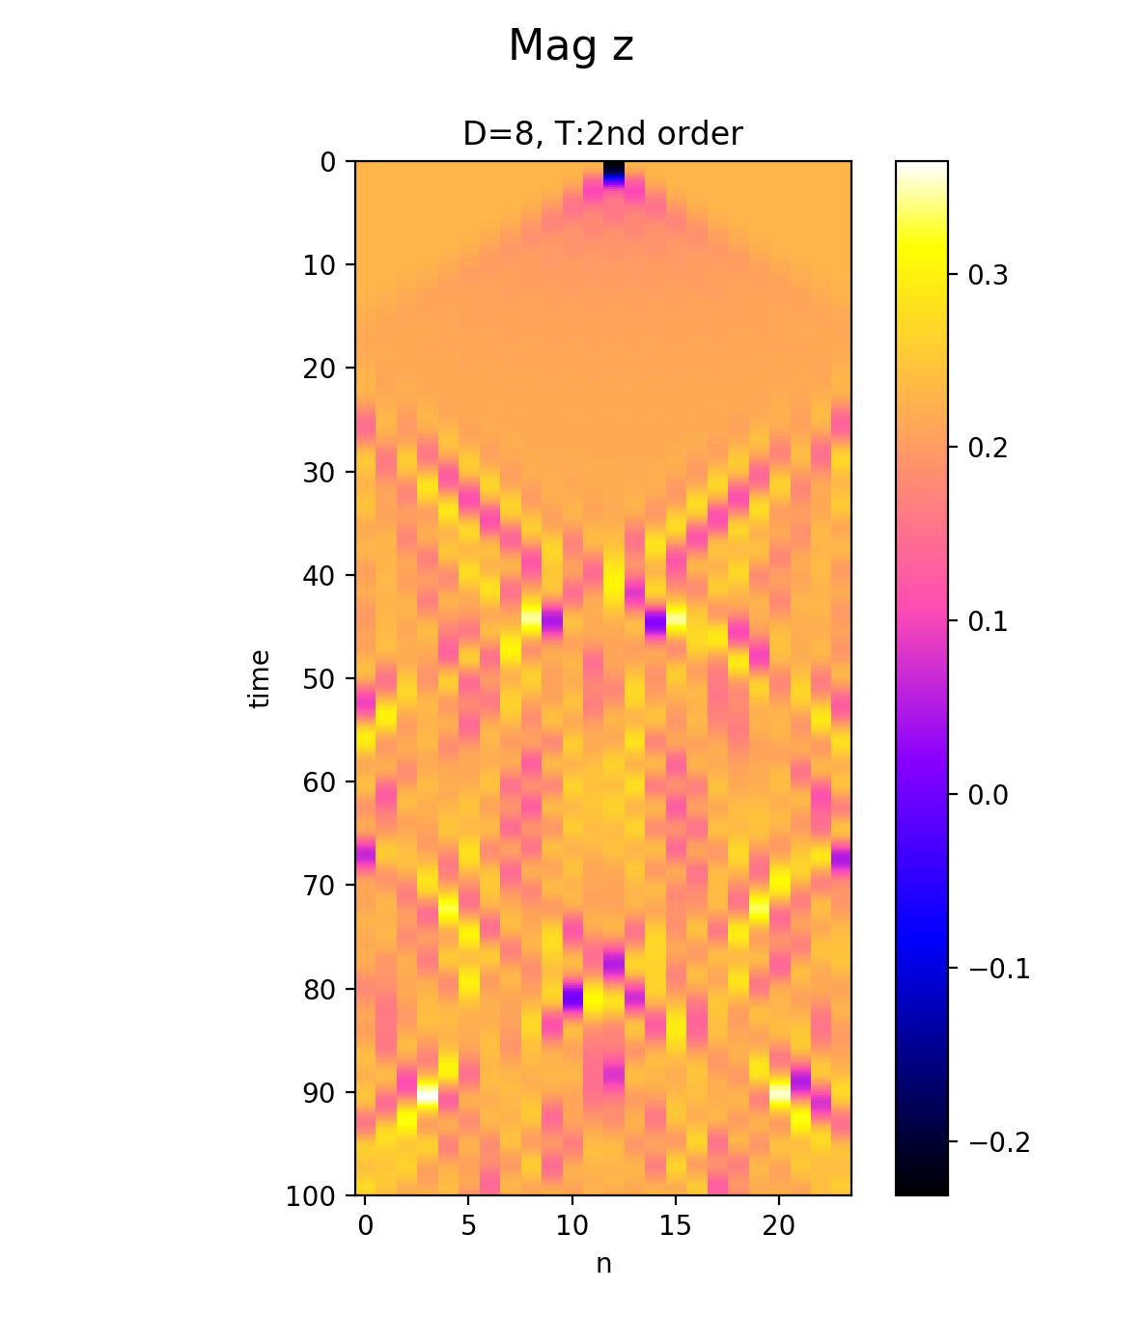
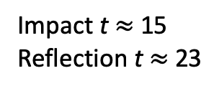
Impact t$≈$ 15
Reflection t $≈$ 23

Slide 6
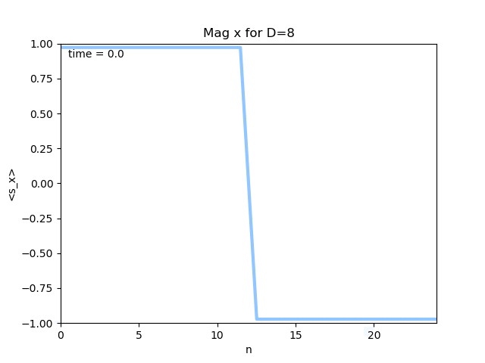
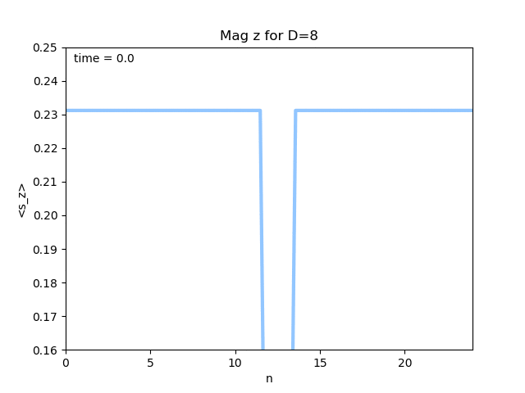
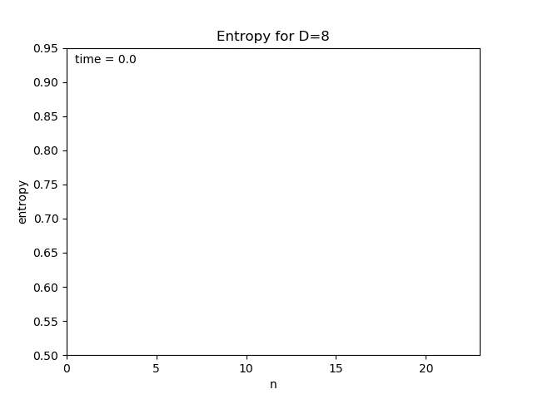
Impact t$≈$ 15
Reflection t $≈$ 23

Slide 7


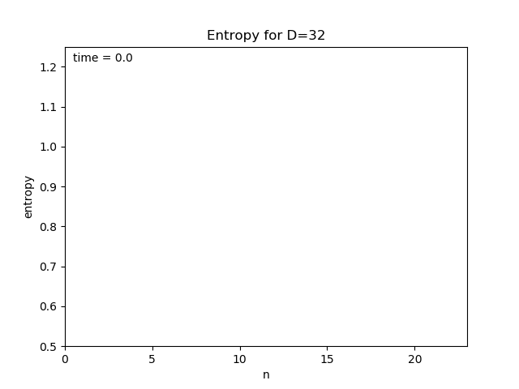
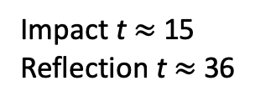
Impact t$≈$ 15
Reflection t $≈$ 36

Slide 8
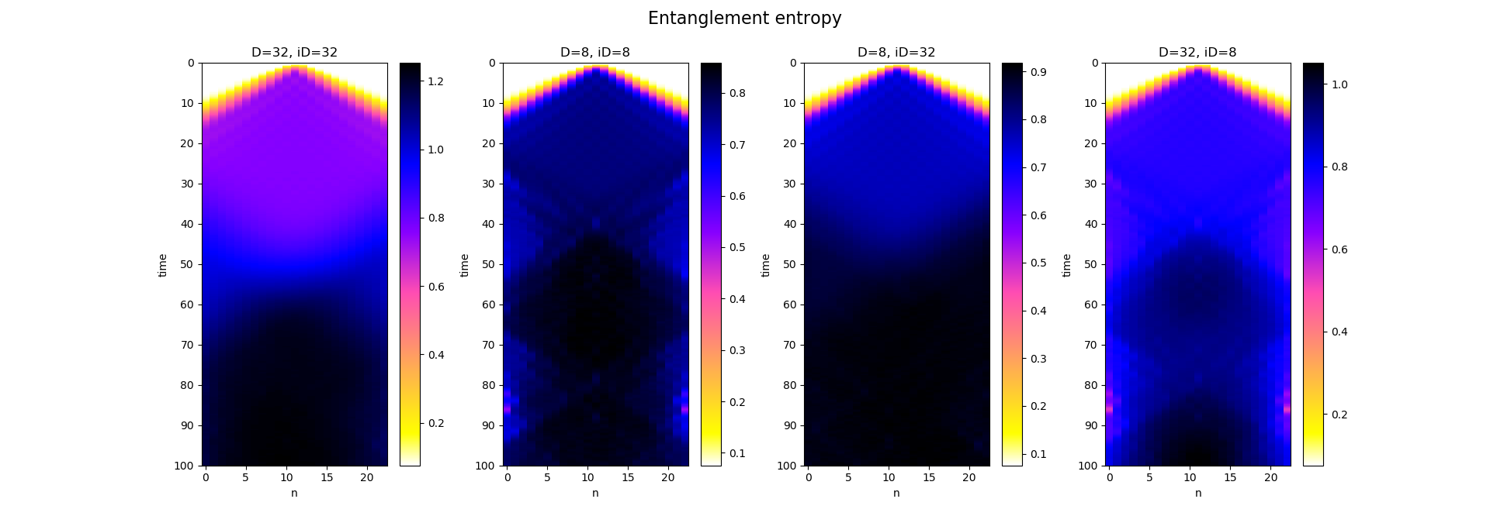
Notes:
- For the behavior of reflection, the bond dimension at the boundary is crucial

Slide 9
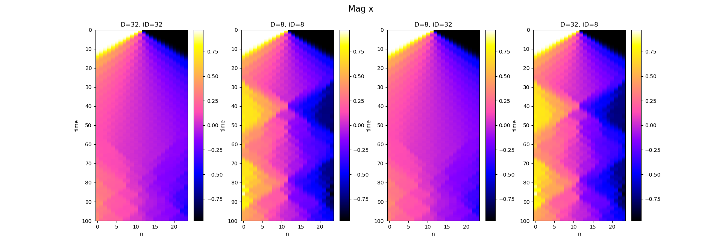
Notes:
- For the behavior of reflection, the bond dimension at the boundary is crucial

Slide 10
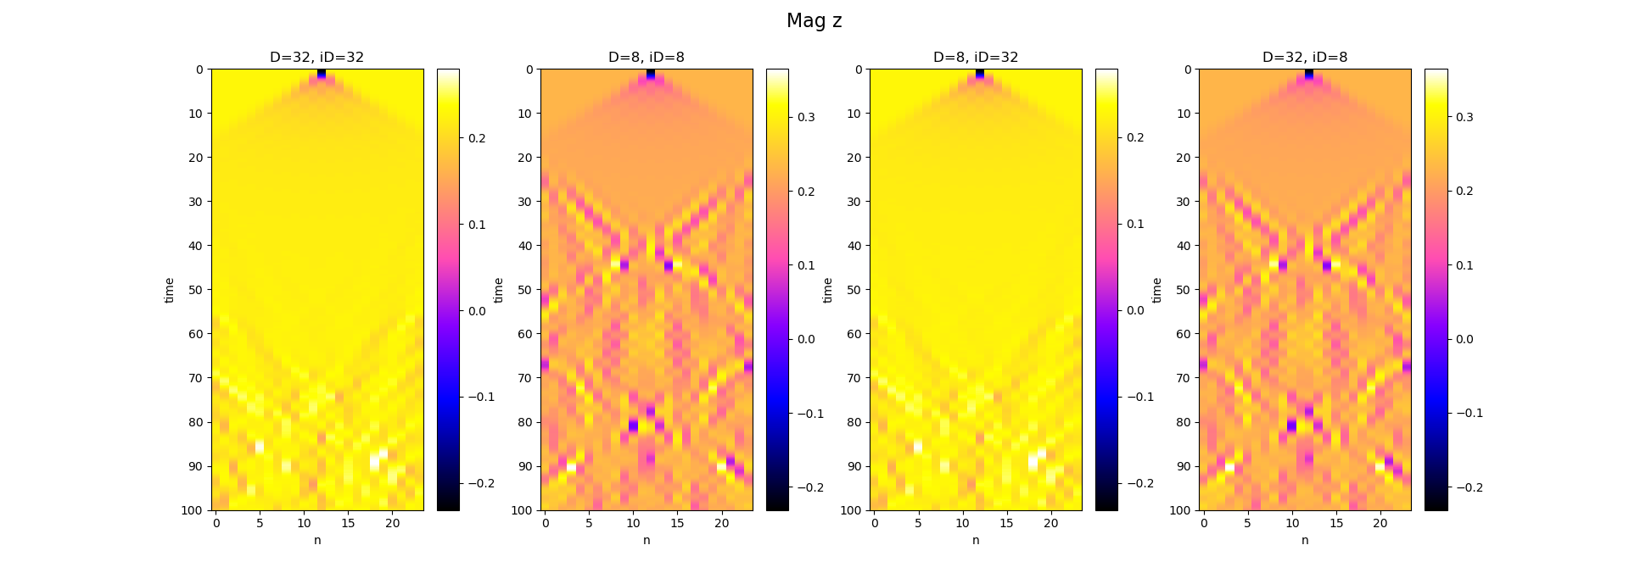
Notes:
- For the behavior of reflection, the bond dimension at the boundary is crucial

Slide 11
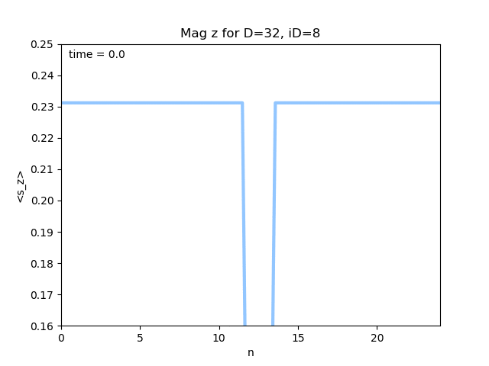

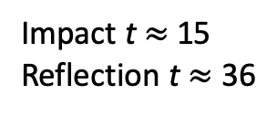
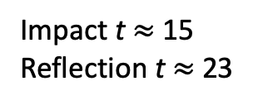
Impact t$≈$ 15
Reflection t $≈$ 23
Impact t$≈$ 15
Reflection t $≈$ 36
Notes:
D=32, iD=8 – equivalent to D=8 everywhere (inside of the window and at the boundary)
D=8, iD=32 – equivalent to D=32 everywhere
For the behavior of reflection, the bond dimension at the boundary is crucial
All the information about signal "entering" the right uniform part is stored in the right-most B tensor (and the information about signal entering the left uniform part is stored only in the left-most A tensor --> so if the bond dimension is small, the computation will explode (this can cause the "reflection")

